Slide 1
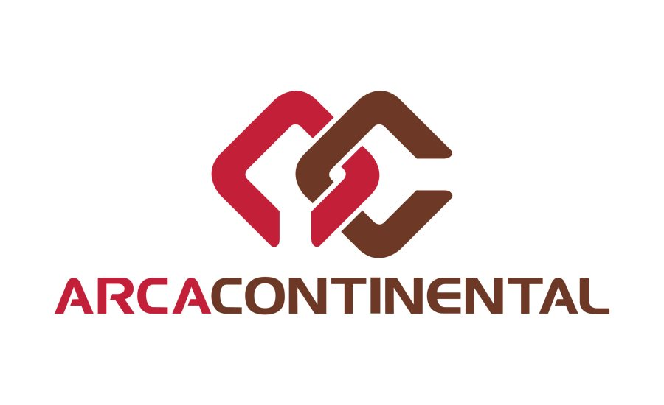
Supplier Portal
Prepared by: Luis Gerardo Villarreal Morales

Slide 2
PROPOSED ARCHITECTURE IN AZURE

Slide 3




























PROPOSED ARCHITECTURE
Data Replication
Standby Region
Active Region
Identity Microservice
Client app
Azure Active Directory
On-premises Active Directory / Azure AD Connect
Estimations Microservice
WebApp MVC
API Management Azure Application Gateway
INGRESS
Orders Microservice
Azure
Service Bus
Internal API Management
Azure Application Gateway
ASP.NET Core MVC Modules
Invoices Microservice
Internal DB
Estimations
Orders
Reports Microservice
Invoices
Azure Blob Storage / Azure Files
Web App
HTML
Responsive
Design
News and manuals Microservice
Reports
News and manuals
Administration Microservice
Administration
SAP PI/PO
Support
Support Microservice
Imports
GoIntegra
Imports Microservice
Azure Functions Scheduled Processes
Multi-Tenancy
Azure Cache Redis
Azure Monitor Log & Analytics
Azure Application Insights
(Email notifications)
Notes:
Ocelot is a lightweight API Gateway, recommended for simpler approaches.
The main reason to choose Ocelot is because Ocelot is a .NET Core lightweight API Gateway that you can deploy into the same application deployment environment where you’re deploying your microservices/containers, such as a Docker Host, Kubernetes, Service Fabric, etc.
Ocelot is an Open Source .NET Core based API Gateway especially made for microservices architecture that need unified points of entry into their system. It’s lightweight, fast, scalable and provides routing and authentication among many other features.

